Slide 1
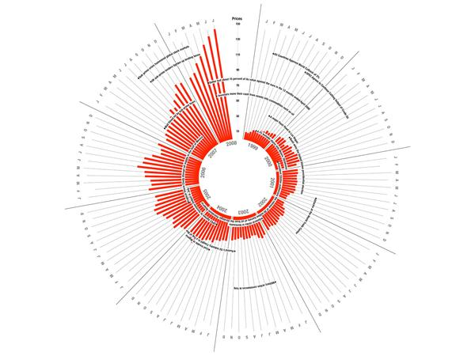
Data Visualization Annotation
MSc in Data Analytics Noel Cosgrave

Slide 2
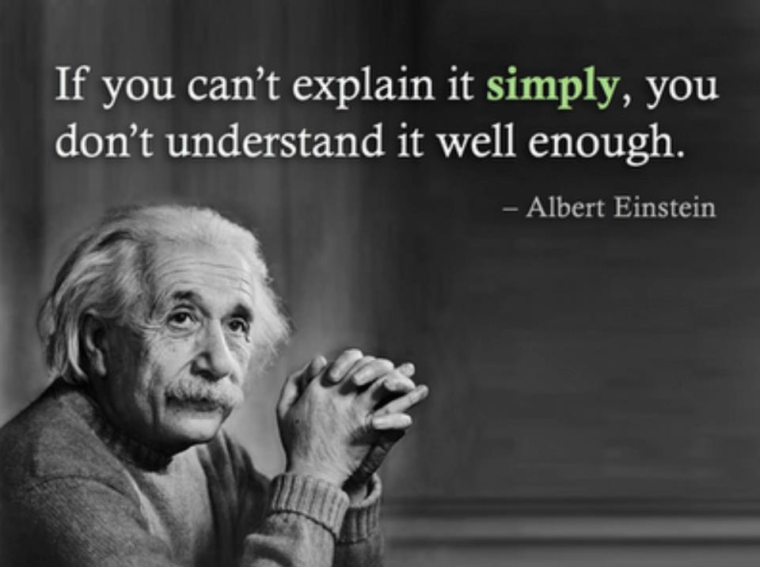
Simple Need to Explain Things

Slide 3

Visualization
What is right amount and type of help?
Annotation: “unquestionably the most neglected layer of the visualization anatomy” (Kirk, 2016)
Least amount of design?
Annotation requires visualisers to truly understand their intended audience
Hugely influential
Directly facilitates understanding

Slide 4
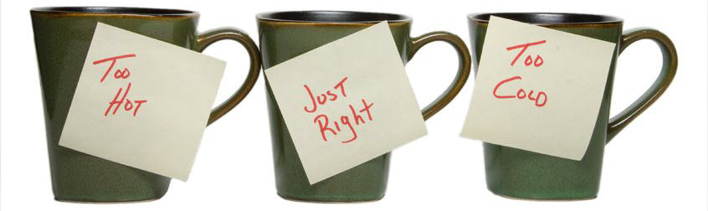
Goldilocks!
Too much annotation?
Cluttered
Overwhelming
Patronising
Too little annotation?
Find your own way
Form your own understanding
Just Right?
Image source: https://smartsellingtools.com/goldilocks-principle-for-sales/

Slide 5
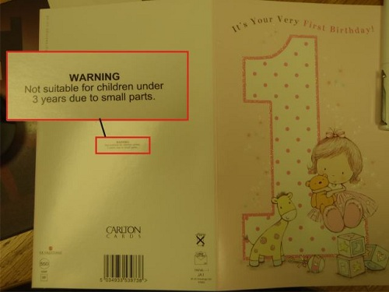
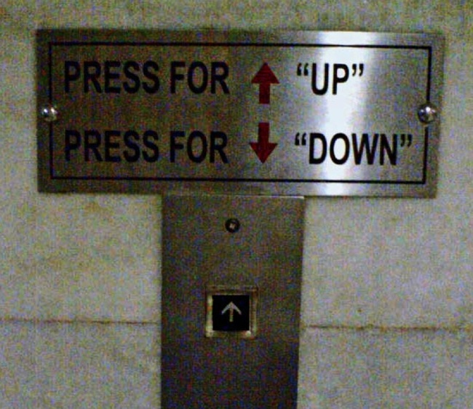
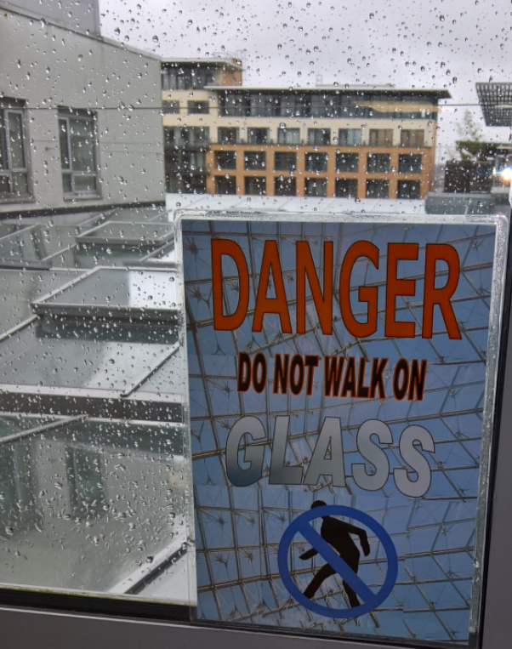
Annotations as Warning Signs!
Image source: http://www.smosh.com/smosh-pit/photos/20-ridiculously-stupid-warning-labels
Image source: http://www.inquisitr.com/1430367/signs-you-dont-need-to-read/
This is a Sign.
Notes:
The Point here is that we are surrounded by annotations telling us in short notes about products, places, people, and many common things our lives.
“Danger” photo by EO’L. Displayed after a Health & Safety audit showed that it was a violation of H&S guidelines that the glass roof over Atrium did not have this sign.

Slide 6
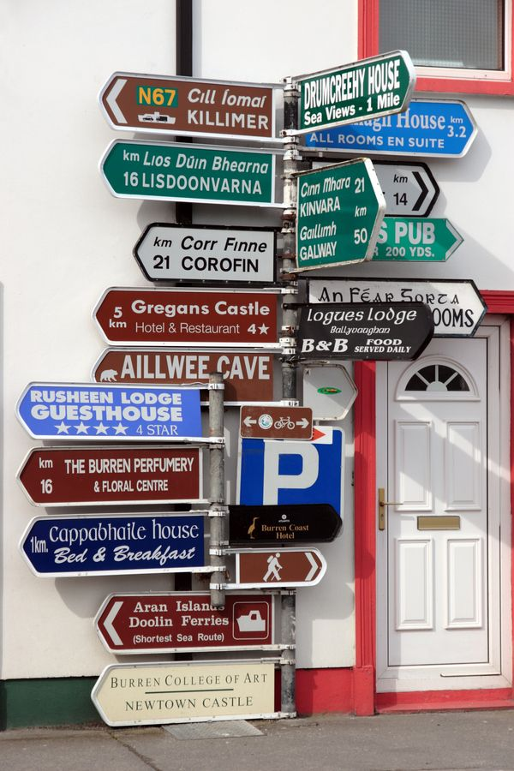

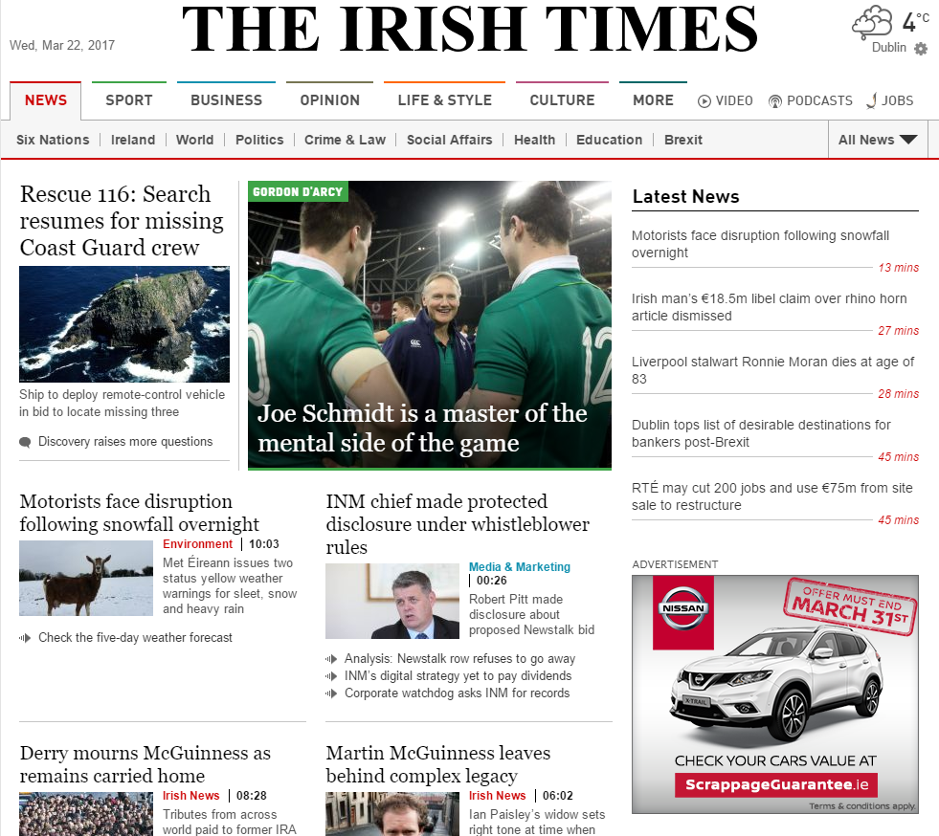
Annotations Everywhere!
Image source: http://www.signwise.ie/products/safety-signs
Image source: https://www.pinterest.com/pin/573646071261662777/
Image source: Screen Shot of Irish Times Website 22nd March, 2017
Notes:
Signposts are located in Ballyvaughan, Co Clare.

Slide 7
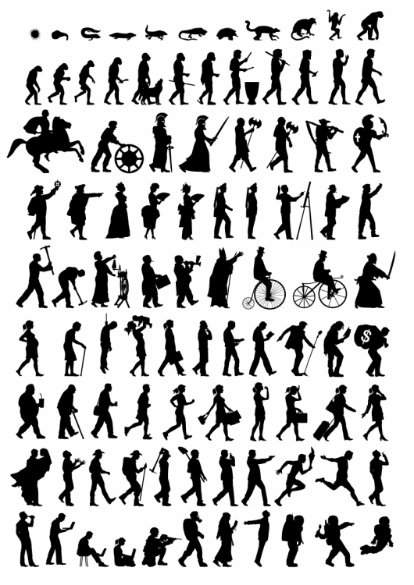
Sometimes Annotation not needed!
Source: http://www.scribblelive.com/blog/2013/10/07/why-infographics-are-a-great-way-to-show-the-history-of-the-world/

Slide 8
Attention Span
Attention Span Statistics | Data
The average attention span in 2015 | 8.25 seconds
The average attention span in 2000 | 12 seconds
The average attention span of a gold fish | 9 seconds
Percent of teens who forget major details of close friends and relatives | 25%
Percent of people who forget their own birthdays from time to time | 7%
Average number of times per hour an office worker checks their email inbox | 30
Average length watched of a single internet video | 2.7 minutes
Source: http://www.statisticbrain.com/attention-span-statistics/
The Telegraph: “Humans have shorter attention span than goldfish, thanks to smartphones”
Notes:
From The Telegraph article: http://www.telegraph.co.uk/science/2016/03/12/humans-have-shorter-attention-span-than-goldfish-thanks-to-smart
The average human's attention span is... oh look, a bird!
According to scientists, the age of smartphones has left humans with such a short attention span even a goldfish can hold a thought for longer.
Researchers surveyed 2,000 participants in Canada and studied the brain activity of 112 others using electroencephalograms.
The results showed the average human attention span has fallen from 12 seconds in 2000, or around the time the mobile revolution began, to eight seconds.
Goldfish, meanwhile, are believed to have an attention span of nine seconds.

Slide 9
Attention Span
Internet Browsing Statistics (Taken from 59,573 page views)
Percent of page views that last less than 4 seconds | 17%
Percent of page views that lasted more than 10 minutes | 4%
Percent of words read on web pages with 111 words or less | 49%
Percent of words read on an average (593 words) web page | 28%
Users spend only 4.4 seconds more for each additional 100 words
Source: Harald Weinreich, Hartmut Obendorf, Eelco Herder, and Matthias Mayer: “Not Quite the Average: An Empirical Study of Web Use,” in the ACM Transactions on the Web, vol. 2, no. 1 (February 2008), article #5.
Source: http://www.statisticbrain.com/attention-span-statistics/

Slide 10
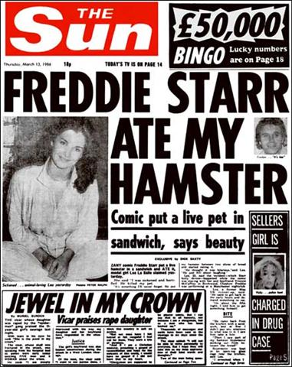
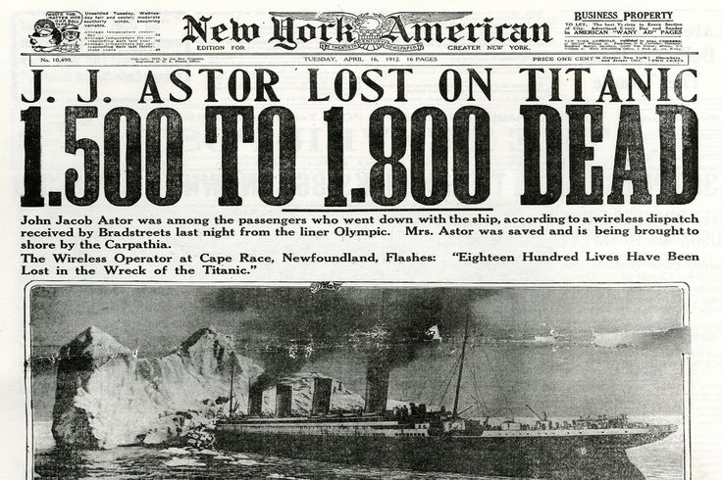
Headlines
Image source: https://www.pinterest.com/pin/465137467737481347/
Image source: https://en.wikipedia.org/wiki/File:Freddiehamster.jpg
Notes:
Headlines – first and simplest form of annotation.

Slide 11
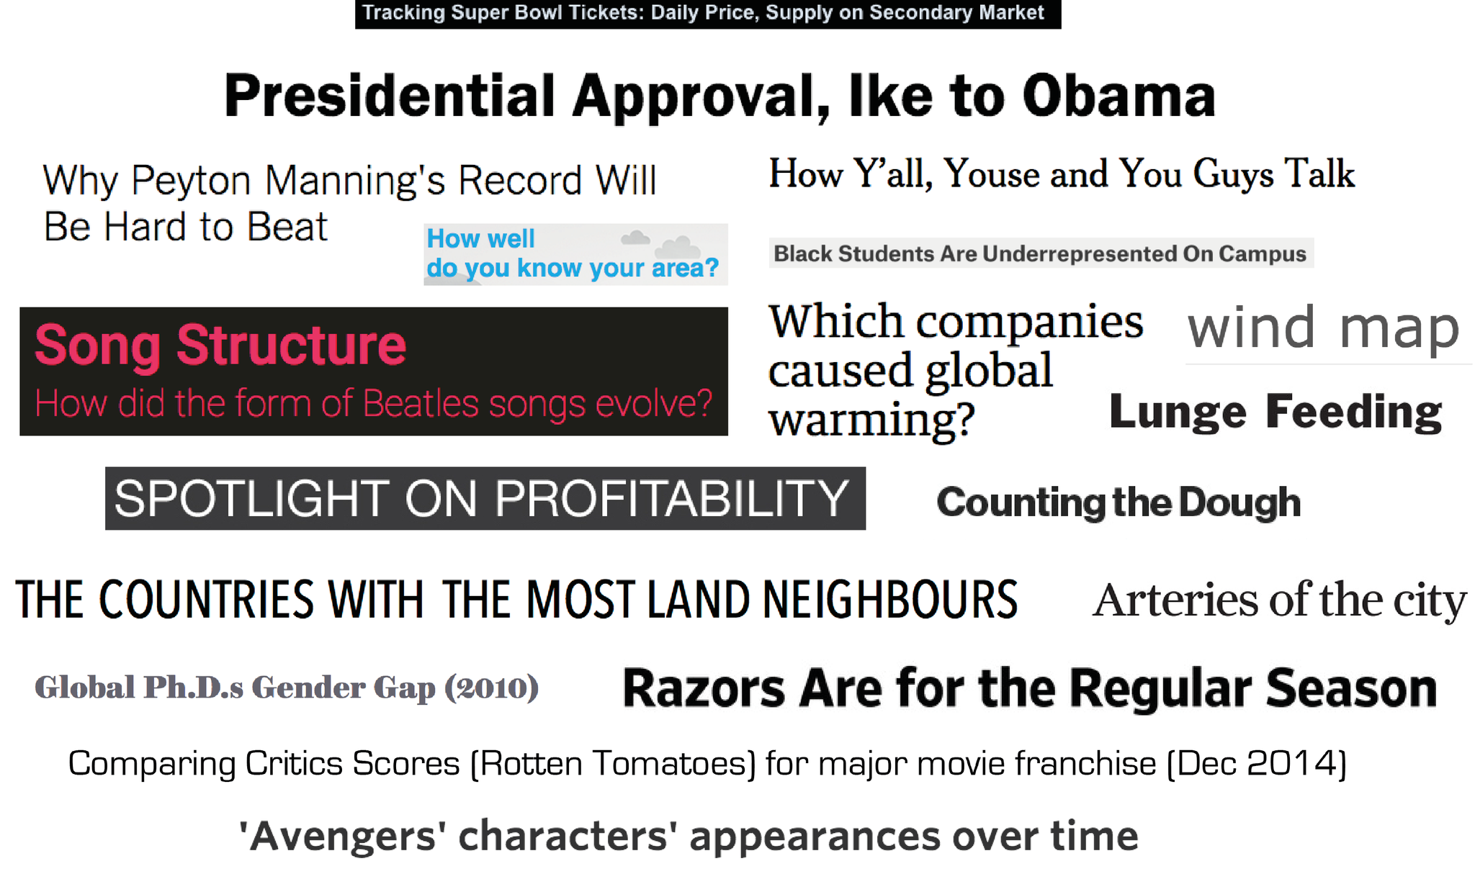
Data Visualization Headlines/Titles
Primary aims of a title:
Get the first sentence read
Inform viewers about the immediate topic/display
Give a fair idea about what they are about to see
Curiosity
Question
Key finding
More functionality
Sub-headings
Section Headings
Chart titles
Image source: https://www.dropbox.com/s/feusre5lfekr7vn/8.1.Titles.png?dl=0
Notes:
URL link is to Andy Kirk web site.
Image is a collage of headlines from Kirk book.

Slide 12
Write Two Headlines (Broadsheet vs Tabloid)
The long-delayed winter weather is on its way. The metropolitan area is expected to have sleet, snow and freezing rain this weekend. After weeks of balmy weather, winter is expected to hit with below-freezing temperatures for several days. The weather alert put Freeport highways crews to work salting down highways and roads. Utility company employees were told to stand by in case of emergencies.
(See more at: http://bit.ly/2ndLDLy)
Notes:
More exercises at: http://highered.mheducation.com/sites/0073511994/student_view0/brush_up/part_v-journalistic_practice2/journalistic_practice_02.html
Suggested answer: “At Last: Winter Is on the Way”

Slide 13
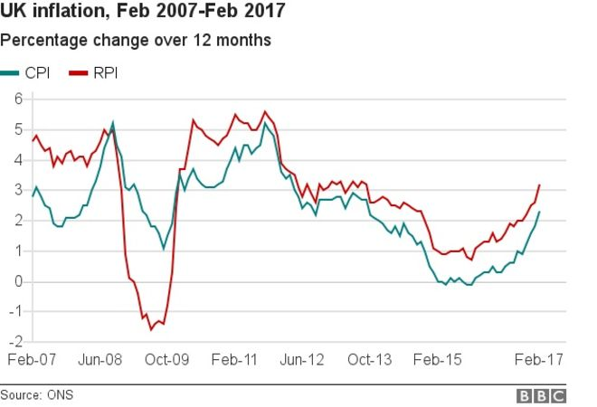
Write a Data Headline
Rising fuel and food prices helped to push last month’s inflation rate to the highest since September 2013.
Inflation as measured by the Office for National Statistics’ Consumer Prices Index (CPI) jumped to 2.3% in February – up from 1.8% in January.
The increase has pushed the rate above the Bank of England’s 2% target.
Food prices recorded their first annual increase for more than two-and-a-half years, standing 0.3% higher in February than a year earlier.
The Bank of England has said it expects inflation will peak at 2.8% next year, although some economists think the rate could rise above 3%.
Story from Hellenic Shipping News
Notes:
http://www.hellenicshippingnews.com/uk-inflation-rate-leaps-to-2-3/
Actual Headline: “UK inflation rate leaps to 2.3%“

Slide 14
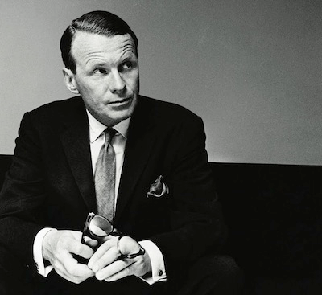
The Four U’s of Headline Writing
Your headline should be Unique
Your headline should be Ultra-Specific
Your headline should convey a sense of Urgency
Your headline should be Useful
(Patel & Putnam, 2013)
On the average, five times as many people read the headlines as read the body copy. When you have written your headline, you have spent eighty cents out of your dollar.
David Ogilvy
Image source: http://www.copyblogger.com/lessons-from-david-ogilvy/
Notes:
Link to Patel and Putnam book: https://www.quicksprout.com/2013/10/07/the-definitive-guide-to-copywriting/
David Ogilvy – Father of Advertising. See more at: https://en.wikipedia.org/wiki/David_Ogilvy_(businessman)
Rare to accomplish all four U’s in a single headline

Slide 15
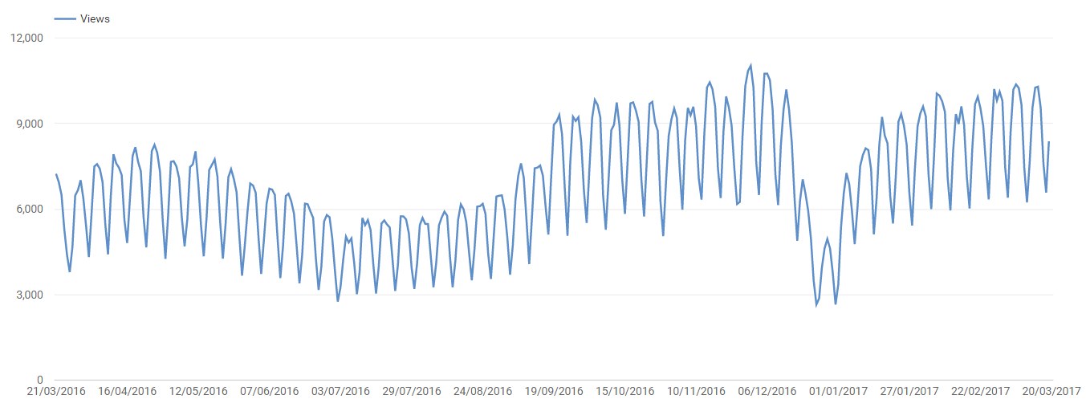
Simple Annotation
30th November
11,020 Views
Summer Decline
New Year’s Day
Christmas Day
Notes:
Eugene’s YouTube Channel Views 2016.

Slide 16
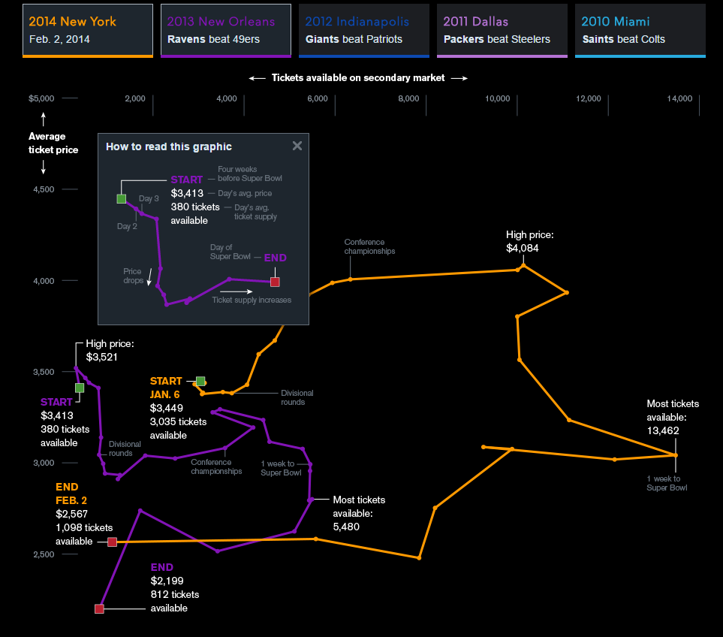
Chart Annotation
Provide viewers with specific assistance for perceiving and interpreting the charts
Features that refer directly to your chart
Features that exist directly within your chart
Features in immediate proximity to your chart
Reading Guides
How to read a chart
Image source: https://www.bloomberg.com/graphics/infographics/tracking-super-bowl-ticket-prices.html

Slide 17
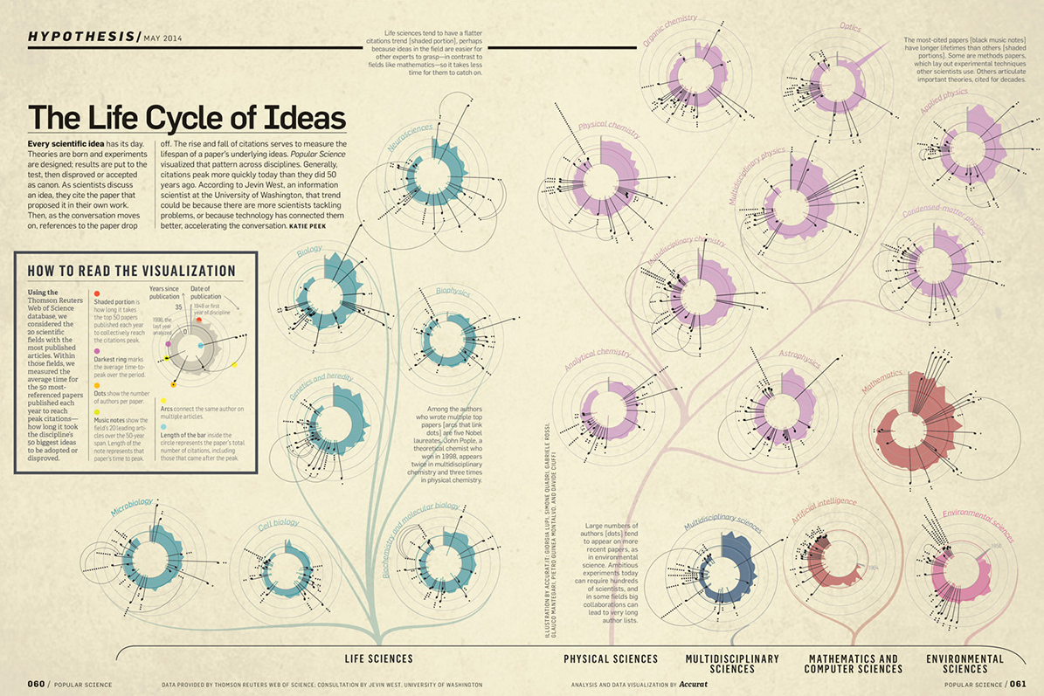
Complexity
Give viewer as much guidance as possible to ensure that chart’s potential is fully realised
Image source: https://www.behance.net/gallery/18719379/The-Life-Cycle-of-Ideas-Popular-Science-Magazine

Slide 18
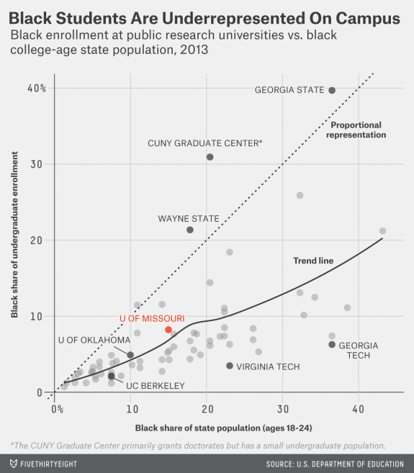
Chart Labels
Three main devices
Axis titles
Axis labels
Value labels
Redundancy
Eg – double labelling
“Labelling is the black magic of data visualization”.
Gregor Aisch (2015)
Image source: https://fivethirtyeight.com/features/mizzous-racial-gap-is-typical-on-college-campuses/
Notes:
Gregor Aisch is Graphics Editor at The New York Times – quote is from interview with Andy Kirk.
http://www.visualisingdata.com/2015/08/six-questions-with-gregor-aisch/

Slide 19
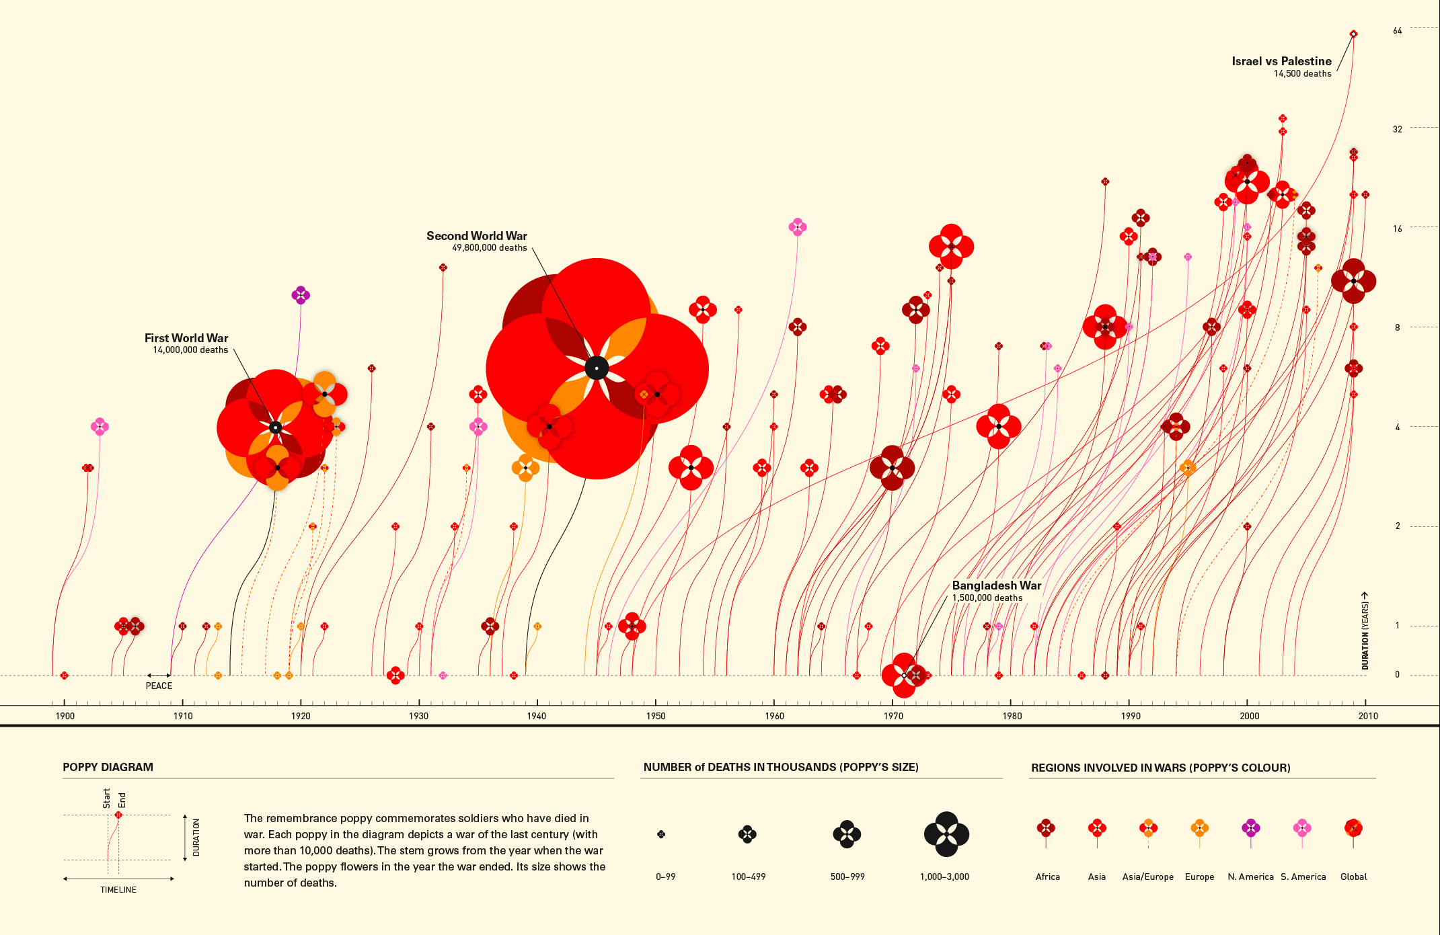
Legends
Annotation beside chart
Presents one (or several) keys to help viewers understand categorical or quantitative meaning of different attributes
Source: http://www.scribblelive.com/blog/2013/10/07/why-infographics-are-a-great-way-to-show-the-history-of-the-world/
Notes:
From “The Infographic History of the World”

Slide 20
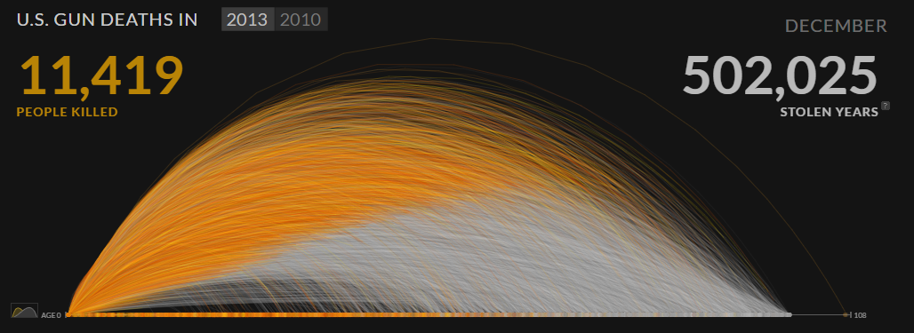
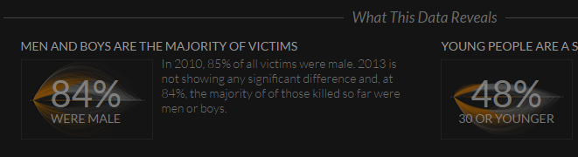
Captions
Small passages of written analysis that bring to the surface some of the main insights and conclusions from the work
May be close to related values inside chart
May be in a separate panel to provide commentary outside the chart
Go to: http://guns.periscopic.com/?year=2013
Notes:
Great animation – get students to view.

Slide 21
Captions with Audio
Notes:
YouTube clip: https://www.youtube.com/watch?v=QPKKQnijnsM
Incorporate non-visual data – incorporate audio as a means of verbally narrating a subject and explaining key messages.

Slide 22
Typography
Typography is the study of letter and word forms and how to visually arrange them
If you are not a designer, you will most likely never need to know about typography
Typefaces vs. Fonts
A typeface, also known as a font family, is a set of fonts.
A typeface contains all of the different variations of a given font such as bold, light, italic, condensed
A font is a specific variation of the font family, such as Helvetica Light
Notes:
Just touching on this subject
Typography Guidelines And References: https://www.smashingmagazine.com/typography-guidelines-and-references/
TYPOGRAPHY 101: A BREAKDOWN OF THE BASICS: https://www.pmg.com/blog/typography-101/

Slide 23

Typography
Serif
Serifs are extensions at the ends of letter strokes
Serifs traditionally function as a means of a leading the eye from one letter to the next, and thus create a more fluid reading process
Serif fonts are best associated with printed reading materials
Sans-Serif
Contrastingly, sans-serif fonts do not have serifs
Sans-serifs are a more modern style and are often the go-to when designing for digital devices
Notes:
An easy way to remember Sans-Serif is that “sans” means “without,” thus a sans-serif is without serifs.

Slide 24
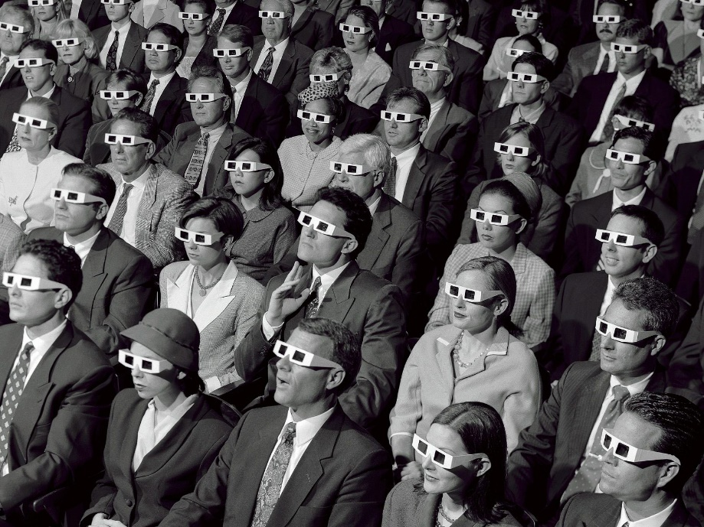
Audience
Think of the reader (eg, a specific person who’s curious, but a novice to the subject and to data visualization) when designing a graphic
Consider:
Subject
Interactive functions
Perceiving
Interpreting
Will audience have knowledge, and ability to understand, interpret, recognise your chart?
Image source: Indie Tips.

Slide 25
Good Design (Andy Kirk, 2016)
The Three Principles of Good Visualization Design
Principle 1
Good data visualization is TRUSTWORTHY
Principle 2
Good data visualization is ACCESSIBLE
Principle 3
Good data visualization is ELEGANT
Notes:
This slide is also in Lecture 3.
Is my visualization design good visual design?

Slide 26
Trustworthy Design
Annotation is one of the most important aids to ensure that you secure and sustain trust from your viewers by demonstrating integrity and openness:
Explain what chart shows (and does not show)
Cite sources
State limitations
Highlight and contextualise
Provide access to coding repositories
Principle 1
Good data visualization is TRUSTWORTHY

Slide 27
Accessible Design
Understandable:
Provide a sufficient level of assistance to achieve understanding
(Remember Goldilocks!)
A setting that is consistent with the need to deliver insights will need suitable annotations
No time (or patience) for long introductions/explanations
Principle 2
Good data visualization is ACCESSIBLE
Notes:
Last point – might actually need “long introduction or explanations” is setting is complex.

Slide 28
Elegant Design
Minimise the clutter
Judge the merits of including textual assistance against the disruption and obstruction caused
Annotations have spatial and visual consequence
Find the most elegant solution for presenting annotations to ensure you do not inadvertently undermine the help you are trying to provide
Principle 3
Good data visualization is ELEGANT

Slide 29
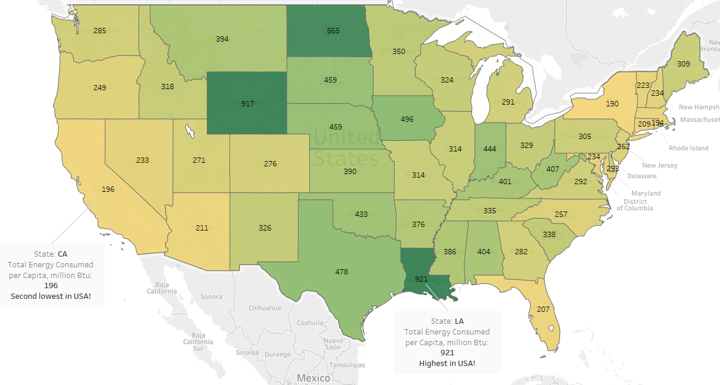
Exercise
Add annotations in Tableau
Online Help
Suggested file (USA Energy Consumption) in Moodle

